Slide 1
Using genome sequencing to identify mutations in evolution experiments
Project Update
05.11.2021

Slide 2
What is genome assembly?
Next generation sequencing
.. TCGTAGC..
GCTACGTAGCTA..
..TCGTAGC..
..GTCGTACGTG..
Genomic DNA
..TTGCTGCATGC..
..TCTCTA..
Millions – billions of reads (30 – 500 bp)
Resequencing
De-novo assembly
Align reads to reference genome and identify variants
Construct genome sequence based on overlaps between reads

Slide 3
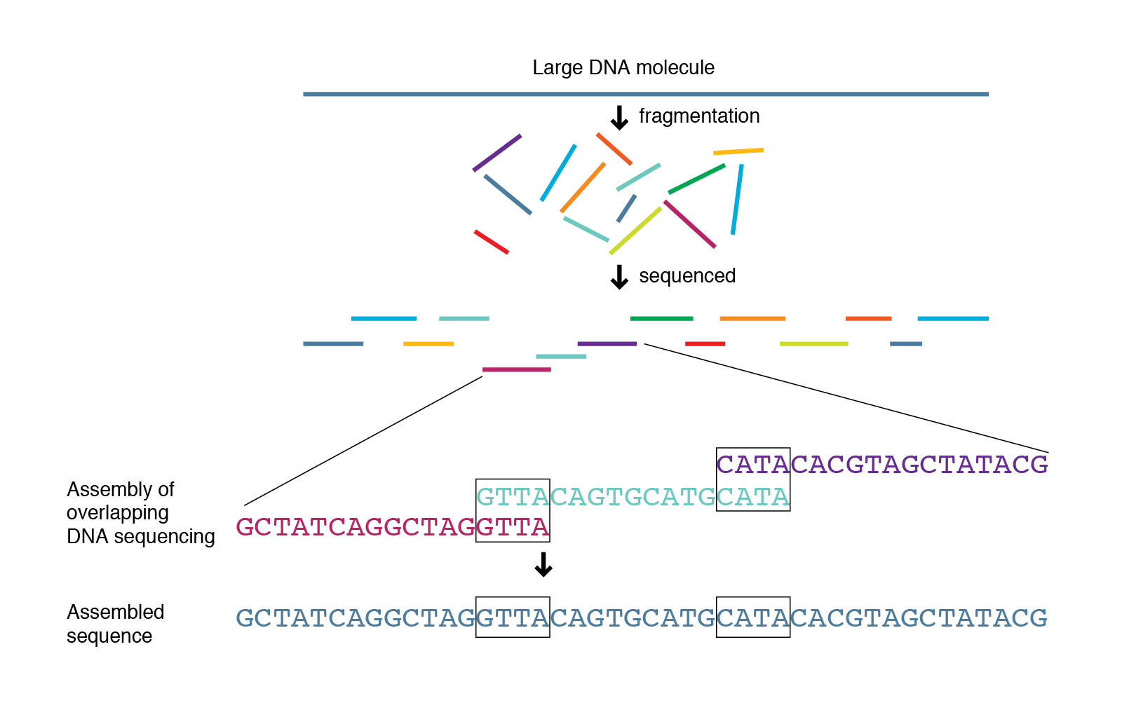
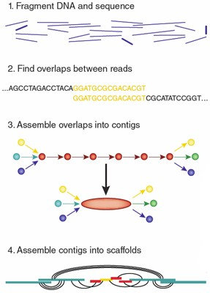
Overview of genome assembly
Areas of research
Improve assembly algorithms
Assemble new genomes
Identify variations in mutant strains
Copy number variation
Insertions / Deletions
Single nucleotide polymorphism
https://www.genome.gov/genetics-glossary/Shotgun-Sequencing

Slide 4
Sequencing technologies
Illumina
< 500 base pair reads
Can do paired end
Millions-billions of reads
Highly accurate, known bias
Relatively even coverage
Cost effective
Repetitive regions
Needs high read depth, based on application (> 50x)
Long Reads
PacBio, Nanopore
1 kb – 100 kb reads
Millions-billions of reads
Long reads
Large coverage, less depth
Expensive
High quality DNA
Error prone, can have systematic errors

Slide 5
Tools for assembly
Alignment steps
Quality check
Alignment
Post alignment analysis
Commonly used aligners
BWA (Burrows-Wheeler Aligner)
bowtie
Subread
Pipelines | Target organisms | Analysis type
Breseq | Prokaryotic, small eukaryotes (Saccharomyces) | Single step analysis
GATK | Originally for human, extended to polyploid organisms | Customizable package with “best-practices” suggestions
SPAdes | All | De-novo assembly

Slide 6
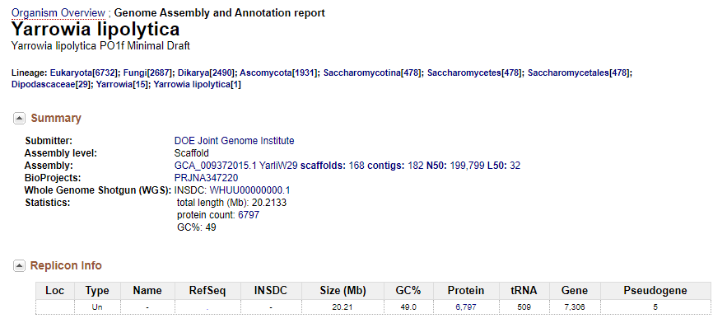
Analysis of evolved mutants in Y. lipolytica PO1f
Parent strain – Yarrowia lipolytica PO1f
Derived from Yarrowia lipolytica W29
Recent genome update: Trinh lab
Experimental work: Sangdo Yook, Jin lab
Strain | Description | Read depth
PO1f | Base strain | 369
16EV | CN evolved from P01f | 386
1EV | CN evolved from P01f | 349
2EV | CN evolved from P01f | 343
41EV | CN evolved from P01f | 319
X123 | P01f + integrated plasmid | 337
XEV | Xylose evolved from X123 | 367
GEV | Glucose evolved from XEV | 369
Walker C, et.al. Draft Genome Assemblies of Ionic Liquid-Resistant Yarrowia lipolytica PO1f and Its Superior Evolved Strain, YlCW001. Microbiol Resour Announc. 2020 Feb, doi: 10.1128/MRA.01356-19

Slide 7
Target output of the analysis
Small (<50 bp)
SNV – single nucleotide (`SNPs`)
◦ Small insertions or deletions (‘Indels’)
Variants vs Errors
distinguish between actual variation (real change) and errors (artifacts) introduced into the analysis
PCR artifacts (amplification of errors)
Sequencing (errors in base calling)
Alignment (misalignment, mis-gapped alignments)
Variant calling (low depth of coverage, few samples)
Genotyping (poor annotation)
Large (Structural variations)
Indels > 50 bp
Copy Number Variations
Inversions
Translocations
Chromosomal fusions

Slide 8
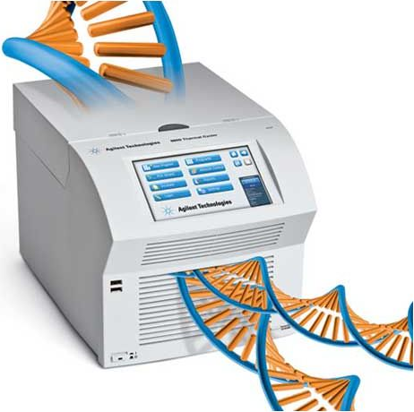

Genome sequencing overview and output
Library preparation by sequencing team at IGB’s Biotechnology Center
1. DNA
Sample fastq file:
@K00363:99:HM3CGBBXX:8:1101:4797:1437 1:N:0:NAAGCTAG+NCATAGCG
ATGCGGAGGTCGAGAACGCGGTTGTCGAGGCGGGTGTCGAGCGCGACCTGGACACCGTCCTCAGCGTCCATGGGGCGGAGGGCCTCGTTGATGGGGAAGG
+
#AAAFAJFAJJAJFFJJJJFFFJJJJJJJJJJJJFJ-F<FAFJFFJ<JAAJFFFJJ<-AA-7<JJF7AFJ-AJJJJF7AFFAF-7AA<<<F7FAF-7A-7
2. Fragmentation
Sequence ID
Sequence
100 bp long
3. Adapter ligation
Quality score (ASCII)
4. Amplification
“Sequencing reads”
5. Sequencing

Slide 9
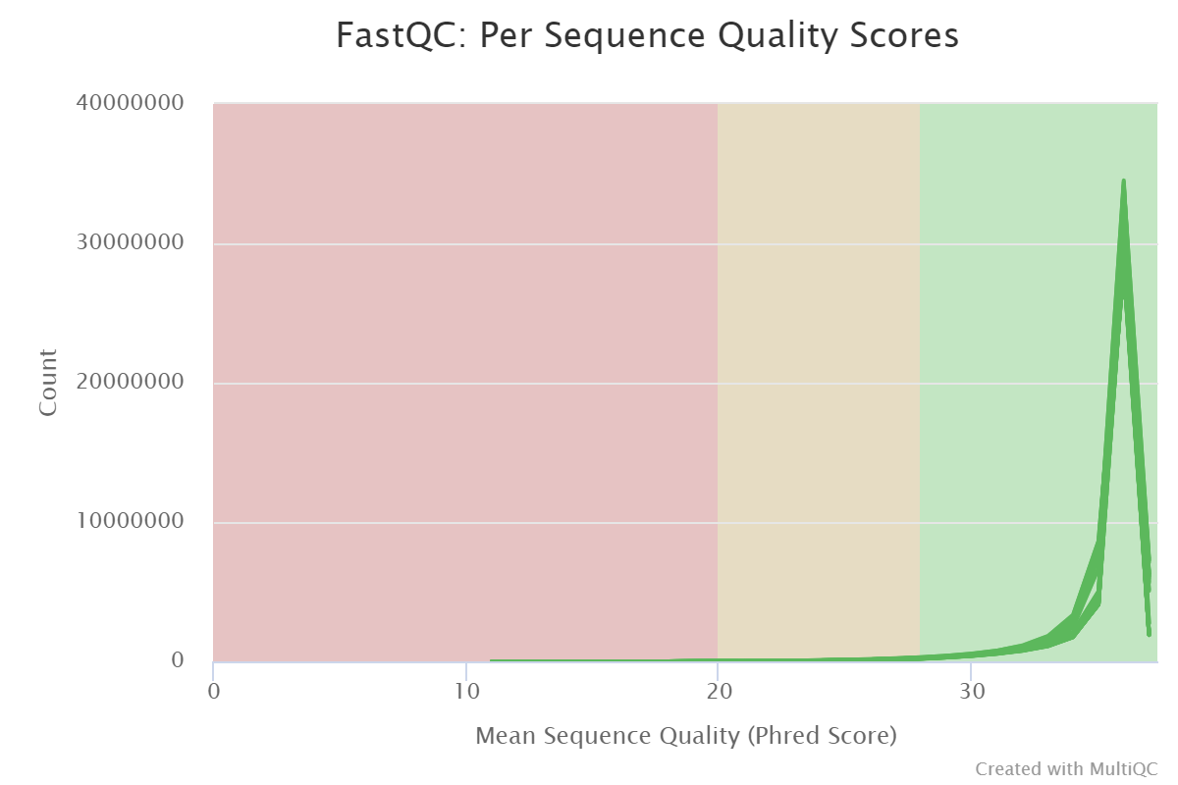
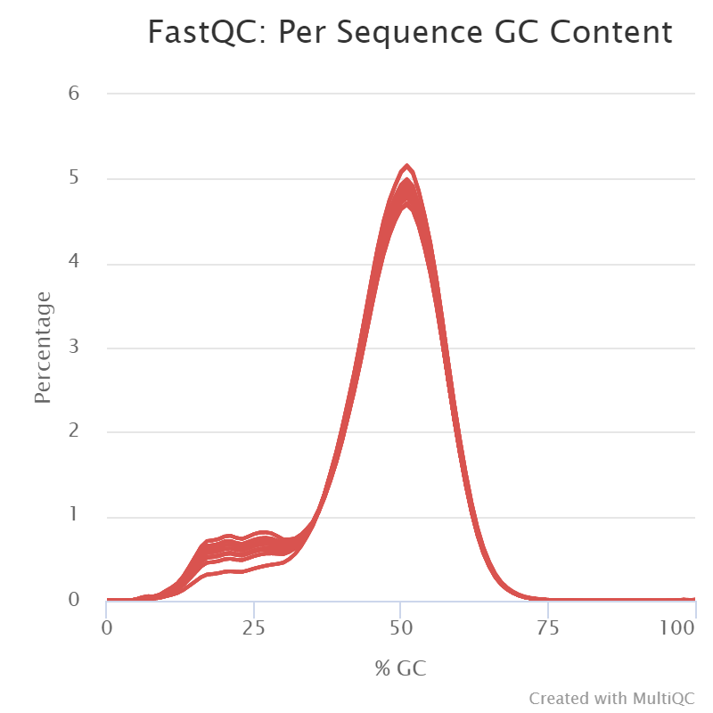
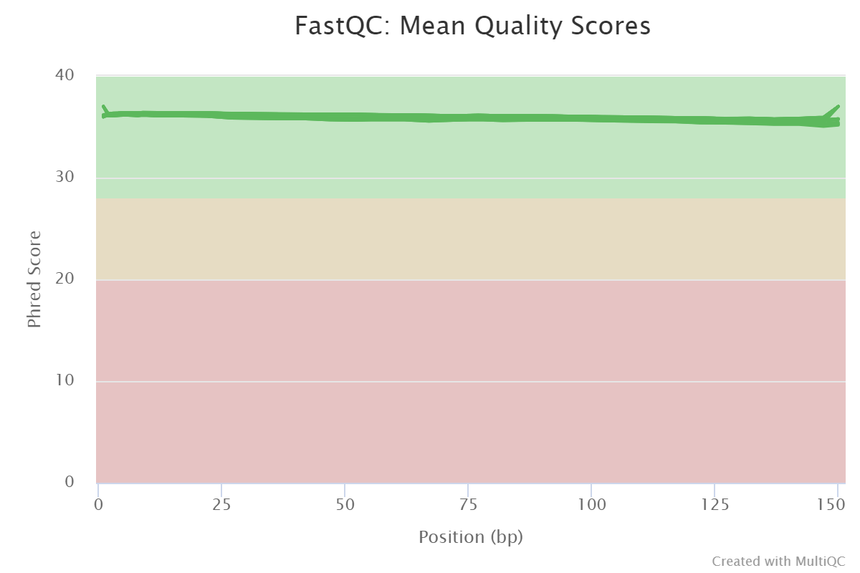
Quality check on trimmed reads

Slide 10


Variant Calling Pipeline
GATK offers “best practices” pipeline suggestions for human cell line analysis
# | Pipeline steps | Module | Functions
0 | Data Cleanup | Trim, FastQC | Trim, FastQC
1 | Genome index and alignment | bwa samtools | bwa-mem view, sort, index
2 | Remove duplicates and sort | gatk | markDuplicates sortSam (by coordinate)
3 | Add read groups, validate SAM | gatk | AddOrReplaceReadGroups ValidateSamFile
4 | Call variants | gatk | HaplotypeCaller
5 | Merge GVCF | gatk | CombineGVCFs GenotypeGVCFs
6 | Hard Filter | gatk | VariantFiltration
7 | Annotation | GenomicRanges GenomicFeatures Rsamtools VariantAnnotation
Pipeline
Align reads
Optimize alignment
Call variants
Filter variants
Annotate

Slide 11
Results - overview
Strain | Description | Read depth | Variants that passed filter | Mutations in a gene
PO1f | Base strain | 369 | 306 | 24
16EV | Evolved from P01f | 386 | 380 | 44
1EV | Evolved from P01f | 349 | 365 | 37
2EV | Evolved from P01f | 343 | 373 | 43
41EV | Evolved from P01f | 319 | 378 | 46
X123 | P01f + xylose pathway | 337 | 326 | 30
XEV | Evolved from X123 | 367 | 340 | 25
GEV | Evolved from XEV | 369 | 311 | 27
In comparison, breseq predicted 2500-3000 mutants

Slide 12
Mutations present in all EV strains (1,2,16,41 EV)
Chromosome | Position | GeneID (PO1f) | Gene details | Consequence | Ref_Codon | Var_Codon | Ref_AA | Var_AA
ML755977.1 | 668759 | BKA90DRAFT_165832 | bHLH transcription factor Yas2p, similar to Saccharomyces cerevisiae INO4 (YOL108C), weakly similar to CA2723|IPF4805 Candida albicans IPF4805 | frameshift | CCG | CG | A | A
ML755979.1 | 453465 | BKA90DRAFT_133266 | aspartic peptidase domain-containing protein, aspartic-type endopeptidase activity|0004190|| | synonymous | GCA | GCG | F | I
ML755979.1 | 469302 | BKA90DRAFT_133279 | Compare to YALI0B05852g, similar to uniprot|similar to Saccharomyces cerevisiae UGO1 (YDR470C); ancestral locus Anc_5.595 | nonsynonymous | TTT | ATT | H | QQHGQQQHGQH
ML755983.1 | 164915 | BKA90DRAFT_166678 | Oxysterol-binding protein-domain-containing protein | Compare to YALI0F16940g, some similarities with uniprot|P35845 Saccharomyces cerevisiae YAR042W SWH1 Protein similar to mammalian oxysterol-binding protein | nonsynonymous | CAT | CAGCAGCACGGTCAGCAGCAGCACGGTCAGCAT | A | S
ML755988.1 | 147622 | BKA90DRAFT_135307 | nucleic acid binding|0003676|| Compare to YALI0F08943g, | nonsynonymous | GCT | TCT | Q | *
ML755994.1 | 173954 | BKA90DRAFT_152173 | - | nonsense | CAA | TAA | P | P
ML755996.1 | 145205 | BKA90DRAFT_136681 | Compare to YALI0F11737g, similar to uniprot|Q6CHL0 Yarrowia lipolytica YALI0A07755g | synonymous | CCT | CCC | D | G
ML756003.1 | 96908 | BKA90DRAFT_19697 | Compare to YALI0C16566g, similar to Saccharomyces cerevisiae RPO21 (YDL140C); ancestral locus Anc_7.314, highly similar to uniprot|P04050 Saccharomyces cerevisiae YDL140c RPO21 DNA-directed RNA polymerase II 215 KD subunit | nonsynonymous | GAT | GGT | T | I

Slide 13
Mutations present in all EV strains (1,2,16,41 EV)
Chromosome | Position | GeneID (PO1f) | Gene details | Consequence | Ref_Codon | Var_Codon | Ref_AA | Var_AA
ML756008.1 | 9483 | BKA90DRAFT_23183 | armadillo-type protein | Compare to YALI0D19536g, weakly similar to uniprot|Q802V5 Brachydanio rerio Similar to TBP-interacting protein | nonsynonymous | ACT | ATT | F | L
ML756011.1 | 11328 | BKA90DRAFT_138635 | general substrate transporter, transmembrane transporter activity|0022857|| Compare to YALI0E20427g, weakly similar to uniprot|P11636 Neurospora crassa Quinate permease (Quinate transporter) | nonsynonymous | TTC | TTA | R | P
ML756012.1 | 182574 | BKA90DRAFT_25851 | fungal-specific transcription factor domain-containing protein Compare to YALI0B06853g, weakly similar to uniprot|P25502 Saccharomyces cerevisiae YKL015w PUT3 Proline utilization trans- activator, similar to Saccharomyces cerevisiae PUT3 (YKL015W); ancestral locus Anc_2.654 | nonsynonymous | CGC | CCC | F | F
ML756016.1 | 129794 | BKA90DRAFT_100026 | Truncated form of YALI0B08338g, similar to uniprot|Q12019 Saccharomyces cerevisiae YLR106C Midasin (MIDAS-containing protein), similar to Saccharomyces cerevisiae MDN1 (YLR106C); ancestral locus Anc_8.295 | synonymous | TTT | TTC | T | A
ML756045.1 | 62600 | BKA90DRAFT_141549 | protein binding|0005515|| Compare to YALI0B17842g, weakly similar to wi|NCU08632.1 Neurospora crassa NCU08632.1 hypothetical protein, similar to Saccharomyces cerevisiae YOL138C; ancestral locus Anc_3.22 | nonsynonymous | ACA | GCA | QQQQQQ | Q
ML756046.1 | 69832 | BKA90DRAFT_141620 | fungal-specific transcription factor domain-containing protein, zinc ion binding|0008270|| Compare to YALI0D09647g, similar to Saccharomyces cerevisiae ARG81 (YML099C); ancestral locus Anc_8.879, weakly similar to uniprot|P05085 Saccharomyces cerevisiae YML099C Arginine metabolism regulation protein II | nonsynonymous | CAACAGCAGCAGCAGCAG | CAG | A | T

Slide 14
Mutations present in all EV strains (1,2,16,41 EV)
Chromosome | Position | GeneID (PO1f) | Gene details | Consequence | Ref_Codon | Var_Codon | Ref_AA | Var_AA
ML756051.1 | 98097 | BKA90DRAFT_141937 | clustered mitochondria-domain-containing protein | Truncated form of YALI0B18810g, weakly similar to uniprot|Q03690 Saccharomyces cerevisiae YMR012w CLU1 translation initiation factor eIF3, similar to Saccharomyces cerevisiae CLU1 (YMR012W); ancestral locus Anc_2.559 | nonsynonymous | GCT | ACT | A | T
ML756051.1 | 98142 | BKA90DRAFT_141937 | clustered mitochondria-domain-containing protein | Truncated form of YALI0B18810g, weakly similar to uniprot|Q03690 Saccharomyces cerevisiae YMR012w CLU1 translation initiation factor eIF3, similar to Saccharomyces cerevisiae CLU1 (YMR012W); ancestral locus Anc_2.559 | nonsynonymous | GCT | ACT | N | D
ML756051.1 | 98397 | BKA90DRAFT_141937 | clustered mitochondria-domain-containing protein | Truncated form of YALI0B18810g, weakly similar to uniprot|Q03690 Saccharomyces cerevisiae YMR012w CLU1 translation initiation factor eIF3, similar to Saccharomyces cerevisiae CLU1 (YMR012W); ancestral locus Anc_2.559 | nonsynonymous | AAC | GAC | F | L
ML756063.1 | 46663 | BKA90DRAFT_149324 | Compare to YALI0C15114g, similar to Saccharomyces cerevisiae CLN3 (YAL040C); ancestral locus Anc_7.36, similar to uniprot|P24866 Candida albicans G1/S- specific cyclin CLN1 | nonsynonymous | TTC | TTG | F | S
ML756066.1 | 10001 | BKA90DRAFT_142577 | Compare to YALI0D08294g, similar to Saccharomyces cerevisiae NUP120 (YKL057C); ancestral locus Anc_2.582, weakly similar to uniprot|P35729 Saccharomyces cerevisiae YKL057c NUP120 nuclear pore protein | nonsynonymous | TTC | TCC | L | F
ML756086.1 | 45198 | BKA90DRAFT_4772 | Compare to YALI0D17754g, weakly similar to uniprot|Q9P4F1 Aspergillus parasiticus Monooxigenase | nonsynonymous | CTT | TTT | G | G
ML756135.1 | 681 | BKA90DRAFT_165592 | - | synonymous | GGT | GGA | A | ALTVPTATALMETATALTVPTATALMVPTATD

Slide 15
Mutations unique to 41EV
Chromosome | Position | GeneID (PO1f) | Gene details |  |  | Consequence | Ref_Codon | Var_Codon | Ref_AA | Var_AA
ML755987.1 | 10778 | BKA90DRAFT_156218 | Compare to YALI0E18700g, weakly similar to uniprot|Q6C7F6 Yarrowia lipolytica YALI0E01210g |  | weakly similar to uniprot|Q6C7F6 Yarrowia lipolytica YALI0E01210g | nonsynonymous | GTT | GCATCTACTTCAGCTGCTACTTCTGTTACAACTACAGCTGATGTT | V | ASTSAATSVTTTADV
ML756050.1 | 97202 | BKA90DRAFT_43958 | - | - | - | frameshift | TTTTTTTTTTTTTTTTTTTTTTTTTTTTTTTTTTTTATT | TTTT
ML756135.1 | 611 | BKA90DRAFT_165592 | - | - | - | nonsynonymous | ACT | ACTCTGCCCGTCACGACCACTGAT | T | TLPVTTTD
ML756135.1 | 615 | BKA90DRAFT_165592 | - | - | - | synonymous | GCT | GCC | A | A
ML756135.1 | 627 | BKA90DRAFT_165592 | - | - | - | synonymous | GGT | GGA | G | G
ML756135.1 | 633 | BKA90DRAFT_165592 | - | - | - | synonymous | ACT | ACC | T | T
ML756135.1 | 651 | BKA90DRAFT_165592 | - | - | - | synonymous | ACC | ACA | T | T
ML756135.1 | 660 | BKA90DRAFT_165592 | - | - | - | synonymous | GGT | GGA | G | G

Slide 16
Mutations unique to 16EV
Chromosome | Position | GeneID (PO1f) | Gene details | Consequence | Ref_Codon | Var_Codon | Ref_AA | Var_AA
ML756014.1 | 135505 | BKA90DRAFT_169240 | BAR domain-containing protein, protein binding|0005515|| Compare to YALI0D13706g, similar to Saccharomyces cerevisiae RVS167 (YDR388W); ancestral locus Anc_5.470, similar to uniprot|P39743 Saccharomyces cerevisiae YDR388w RVS167 Reduced viability upon starvation | synonymous | CTC | CTA | L | L

Slide 17
Mutations of interest in 1,2,16,41 EV
Location | Chromosome | Position | GeneID (PO1f) | Gene details | Consequence | Ref_Codon | Var_Codon | Ref_AA | Var_AA
Present in 16EV, 2EV | ML756010.1 | 94663 | BKA90DRAFT_174726 | Compare to YALI0C12364g, some similarities with uniprot|Q03125 Saccharomyces cerevisiae YDR043c NRG1 transcriptional repressor for glucose repression of STA1 gene expression | frameshift | TAC | TACC
Present in PO1f,2EV | ML756101.1 | 1241 | BKA90DRAFT_171513 |  | nonsynonymous | GCT | GCTCTGACGGTTCCAACGGCAACGGCTCTGATGGAAACGGCAACGGCTCTGACGGTTCCAACGGCAACGGCTCTGATGGTTCCAACGGCAACGGAT
Absent in 16Ev,41EV | ML755980.1 | 222545 | BKA90DRAFT_133446 | Compare to YALI0F05346g, weakly similar to uniprot|Q00858 Fusarium solani Cutinase gene palindrome-binding protein | frameshift | ATG | CACACACACACACACACACACACACACACACACACACACACACACACACAATG | M | HTHTHTHTHTHTHTHTHTHTHTM
Absent in 16Ev,41EV | ML755980.1 | 222545 | BKA90DRAFT_133446 | Compare to YALI0F05346g, weakly similar to uniprot|Q00858 Fusarium solani Cutinase gene palindrome-binding protein | frameshift | ATG | CACACACACACACACACACACACACACACACACACACACACACACACACACACACACACACAATG | L | L

Slide 18
Mutations of interest (1,2,16,41 EV)
Location | Chromosome | Position | GeneID (PO1f) | Gene details | Consequence | Ref_Codon | Var_Codon | Ref_AA | Var_AA
Absent in 16Ev,41EV | ML755980.1 | 222545 | BKA90DRAFT_133446 | Compare to YALI0F05346g, weakly similar to uniprot|Q00858 Fusarium solani Cutinase gene palindrome-binding protein | nonsynonymous | ATG | CACACACACACACACACACACACACACACACACACACACACACACACACACACACACACACACACAATG | Y | Y
Absent in 1EV | ML756065.1 | 411 | BKA90DRAFT_47813 | Compare to YALI0F01518g, some similarities with uniprot|Q6CF33 Yarrowia lipolytica YALI0B10626g | synonymous | CTG | CTT | A | APLPLAEPMPLPLATLAPLPLAEPMPLPLAEPMPLPLAEPM
Absent in 1EV | ML756065.1 | 414 | BKA90DRAFT_47813 | Compare to YALI0F01518g, some similarities with uniprot|Q6CF33 Yarrowia lipolytica YALI0B10626g | synonymous | TAC | TAT
Absent in 2EV, 41EV | ML756101.1 | 143 | BKA90DRAFT_171513 | - | nonsynonymous | GCG | GCGCCTCTTCCACTGGCGGAGCCGATGCCTCTTCCACTGGCGACTCTGGCGCCTCTTCCACTGGCGGAGCCGATGCCTCTTCCACTGGCGGAGCCGATGCCTCTTCCACTGGCGGAGCCGATG

Slide 19
Mutations unique to XEV
 | SNP | GeneID (PO1f) | Gene details | Consequence | Ref_Codon | Var_Codon | Ref_AA | Var_AA
Mutations present in XEV only | ML755980.1:222545 | BKA90DRAFT_133446 | Compare to YALI0F05346g, weakly similar to uniprot|Q00858 Fusarium solani Cutinase gene palindrome-binding protein | frameshift | ATG | CACACACACACACACACACACACACACACACACACACACACACACACACAATG
 | ML755980.1:222545 | BKA90DRAFT_133446 | Compare to YALI0F05346g, weakly similar to uniprot|Q00858 Fusarium solani Cutinase gene palindrome-binding protein | frameshift | ATG | CACACACACACACACACACACACACACACACACACACACACACACACACACACACACACACACACACAATG
 | ML756056.1:38416 | BKA90DRAFT_117863 | rab-GTPase-TBC domain-containing protein, Rab GTPase activator activity|0005097||Compare to YALI0B12100g, similar to uniprot|Q9HEH2 Neurospora crassa Related to GTPase activating protein, similar to Saccharomyces cerevisiae GYP1 (YOR070C); ancestral locus Anc_5.672 | nonsynonymous | TCT | TTT | S | F
Mutations absent in XEV only | ML755987.1:10778 | BKA90DRAFT_156218 | Compare to YALI0E18700g, weakly similar to uniprot|Q6C7F6 Yarrowia lipolytica YALI0E01210g | nonsynonymous | GTT | GCATCTACTTCAGCTGCTACTTCTGTTACAACTACAGCTGATGTT | V | ASTSAATSVTTTADV

Slide 20
Mutations unique to GEV
 | SNP | GeneID (PO1f) | Gene details | Consequence | Ref_Codon | Var_Codon | Ref_AA | Var_AA
Mutations present in GEV only | ML756000.1:189049 | BKA90DRAFT_137339 | Compare to YALI0E23474g, uniprot|O74129 Yarrowia lipolytica alkane utilisation CYP52 family member | synonymous | GAC | GAT | D | D
 | ML756022.1:35852 | BKA90DRAFT_114983 | Compare to YALI0C01199g, no similarity | nonsynonymous | CAA | CACTTTTTTTAA | Q | HFF*
 | ML756050.1:97202 | BKA90DRAFT_43958 | - | frameshift | TTTTTTTTTTTTTTTTTTTTTTTTTTTTTTTTTTTTATT | TTTT
Mutations absent in GEV only | ML756065.1:411 | BKA90DRAFT_47813 | Compare to YALI0F01518g, some similarities with uniprot|Q6CF33 Yarrowia lipolytica YALI0B10626g | synonymous | CTG | CTT | L | L
 | ML756065.1:414 | BKA90DRAFT_47813 | Compare to YALI0F01518g, some similarities with uniprot|Q6CF33 Yarrowia lipolytica YALI0B10626g | synonymous | TAC | TAT | Y | Y
 | ML756101.1:143 | BKA90DRAFT_171513 | - | nonsynonymous | GCG | GCGCCTCTTCCACTGGCGGAGCCGATGCCTCTTCCACTGGCGACTCTGGCGCCTCTTCCACTGGCGGAGCCGATGCCTCTTCCACTGGCGGAGCCGATGCCTCTTCCACTGGCGGAGCCGATG | A | APLPLAEPMPLPLATLAPLPLAEPMPLPLAEPMPLPLAEPM
 | ML756123.1:10963_C/T | BKA90DRAFT_171652 | - | nonsynonymous | GCC | GTC | A | V

Slide 21
Mutations present in both XEV and GEV
 | SNP | GeneID (PO1f) | Gene details | Consequence | Ref_Codon | Var_Codon | Ref_AA | Var_AA
Mutations present in both XEV and GEV | ML755987.1:99826 | BKA90DRAFT_109120 | Compare to YALI0E18117g, similar to uniprot|P39940 Saccharomyces cerevisiae YER125W Ubiquitin--protein ligase RSP5 | nonsynonymous | GAC | AAC | D | N
 | ML756032.1:125085 | BKA90DRAFT_35865 | Compare to YALI0F32065g, no similarity | frameshift | GTGCCC | GTGCC
 | ML756051.1:17305 | BKA90DRAFT_141891 | Gti1/Pac2 family-domain-containing protein | Compare to YALI0B18282g, similar to uniprot|O14367 Schizosaccharomyces pombe Gluconate transport inducer 1 | nonsense | CAG | TAG | Q | *

Slide 22
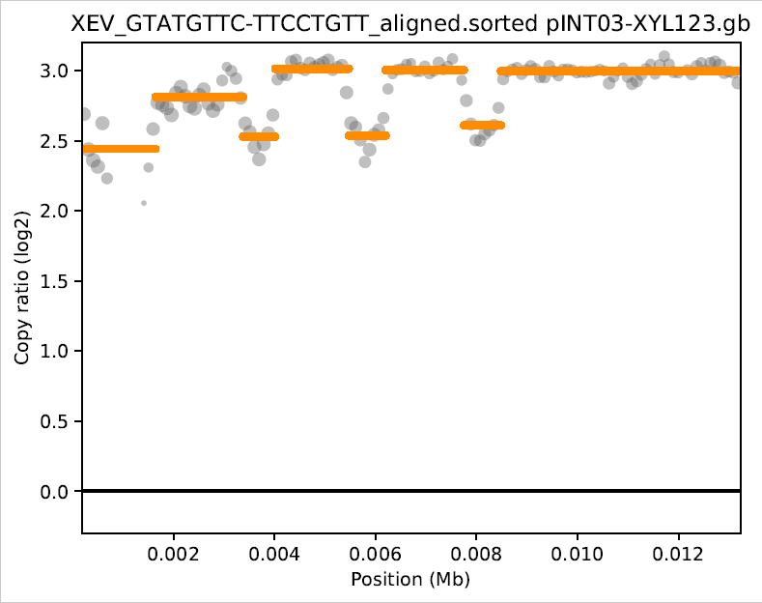
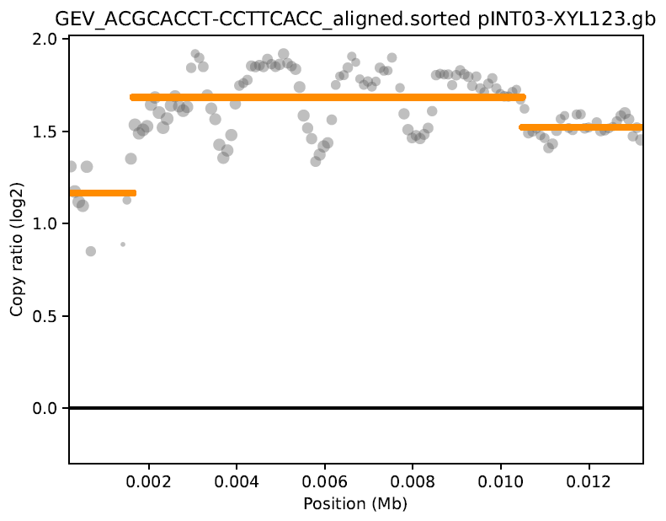
Copy number variation
Analysis using CNVkit pipeline
Median values | Read Depth |  |  | Copy Number
Gene from plasmid | X123 | XEV | GEV | XEV / X123 | GEV / X123 | XEV / GEV
Xyl1 | 789 | 5699 | 2482 | 7.22 | 3.16 | 2.29
Xyl2 | 869 | 5870 | 2535 | 6.78 | 2.91 | 2.32
Xyl3 | 835 | 5716 | 2407 | 6.83 | 2.90 | 2.36
Complete plasmid | 787 | 5428 | 2062 | 6.74 | 2.77 | 2.31
Analysis using read depth

